Slide 1

Hall Management System
Knowledge & Technology
Bangladesh Army University of Engineering & Technology ( BAUET)
Qadirabad Cantonment, Natore-6431
Presented by:
1.Name: Sadia Khanam
ID: 19204003
2. Name: Jeba Afia
ID: 19204045
3.Name: Mohammad Ali Nayem
ID: 18204033
Batch: 10th
Supervised by:

Slide 2
Outlines
Introduction
Existing State of the Problem
Limitations of Existing State
Objectives
Gantt Chart
ER Diagram
Data Flow Diagram
Table View
Structured Chart
Use case Diagram
Features of Our System
Requirements of Our System
Project View
Conclusions
Future Works
References

Slide 3
Introduction
This system is designed in the favor of the Hall Management, which helps them to save the records of the students about their rooms and other things.
It helps them from the manual work from which it is very difficult to find the record of the students and the mess bills of the students, and the information about those students who left the hostel some years before.
It also helps them to retrieve the staff details.
This system also carries out the automatic allotment or evacuation of rooms for the students and also, automatically calculates all the bills and issues the notifications for those students who are against some rules.
Thus, in order to ease the process, we need to develop software which can handle all the aforementioned problems.
To replace the existing system which is much more time consuming, we are developing a software which is user-friendly and its functionality is very good compared to the existing one.

Slide 4
Existing State of Problem
The current hall management system involves hand-written records that are stored into various registers.
This requires a lot of time as well as manpower.
Each department has its own register and the student and staff registers are maintained on a daily basis.
It is very difficult to maintain or update all the records and retrieving a certain data from such a number of registers is almost impossible.
Also, the loss or damage of any of the registers leads to the damage of hundreds of records at a time.

Slide 5
Limitations of Existing State
Records are hand-written in registers.
Too many registers for too much information.
Registers are not very well maintained.
Any types of details are not available easily.
Any type of loss or damage of these registers causes the loss of many records at a time.

Slide 6
Objectives
This software makes the user to store the details of the student in a data base and it is easy to retrieve the data whenever necessary.
We can say that this product has the highest priority because it is going to be a good product according to us.
User should log in this software to use it. It can be used only by one person called the Manager to enter the student/staff records etc.
Its validation is done standard as it looks very impassive system product.

Slide 7
Gantt Chart
Task | Jan | Feb | Mar | April
Task 1 Planning
Task 2 Design
Task 3 Implementation
Task 4 Testing
Task 5 Deployment and Maintenance
Fig 1: Gantt Chart

Slide 8
ER Diagram
Meal_charge
Hall_id
Name
Stud_id
Phone
Email
Student
View
Hall Dues
Hall_charge
Room_no
Update
Approve
Room_no
View
Username
Hall Office
Day
Update
Meal Chart
Password
Hall_id
Meal
Fig 2: ER Diagram

Slide 9
Data Flow Diagram
Create
Account
Approve
Student
Student
Hall Management
System
Hall Office
View Hall
Details
Update Hall
Data
Student
Database
Fig 3: Data Flow Diagram

Slide 10
Table View
Student
Hall Dues
Stud_id
Phone
email
Room_no
Hall_id
Meal_id
Hall_id
Meal_Charge
Hall_Charge
Total_Charge
Hall Office
Meal Chart
Username
Password
Meal_id
Hall_id
Stud_id
Meal_id
Day
Lunch
Breakfast
Dinner
Fig 4: Table View

Slide 11
Structured Chart
Hall Management System
Student
Hall Office
View Meal
Chart
Update Meal
Details
Update Student
Details
View Student Details
Hall Dues
Fig 5: Structured Chart

Slide 12
Use Case Diagram
Sign In
Assign Complain
View Meal Chart
Hall Provost
View Hall Dues
Student
Assign House Tutor
Take Action on Complain
Hall Office
Fig 6: Use Case Diagram

Slide 13
Features of Our System
1. Student Section:
Sign In
View Meal Chart
View House Tutor
View Allotment
View Profile
View Dues
View House Tutor
Give Complaints
2. Hall Section:
Approve Student
Update Meal Chart
Update Dues
Update House Tutor
Take Action on Complain

Slide 14
Requirements of Our System
Software Requirements:
i. VS Code/ Notepad++
ii. Xampp
Programming Language:
i. Html, CSS
ii. Php
iii. JavaScript
iv. SQL
Hardware Requirements:
i. PC Processor: Core i5 10th Generation
ii. Ram: 4GB
iii. HDD: 500 GB

Slide 15
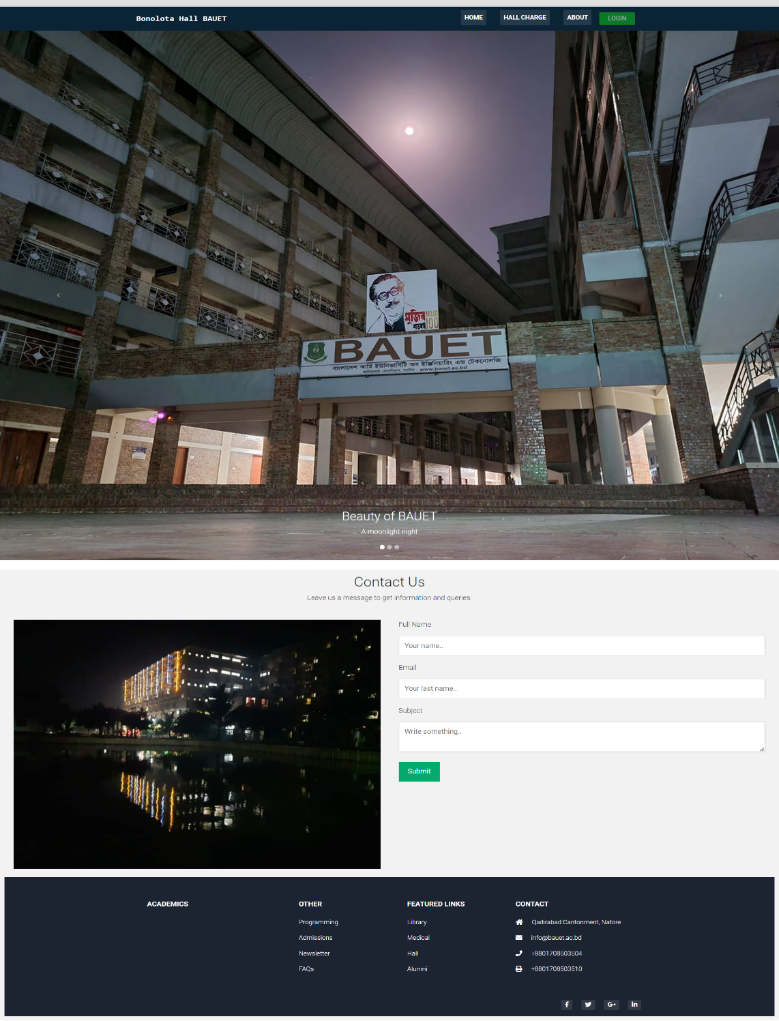
Project View
Fig 7: Main Page

Slide 16
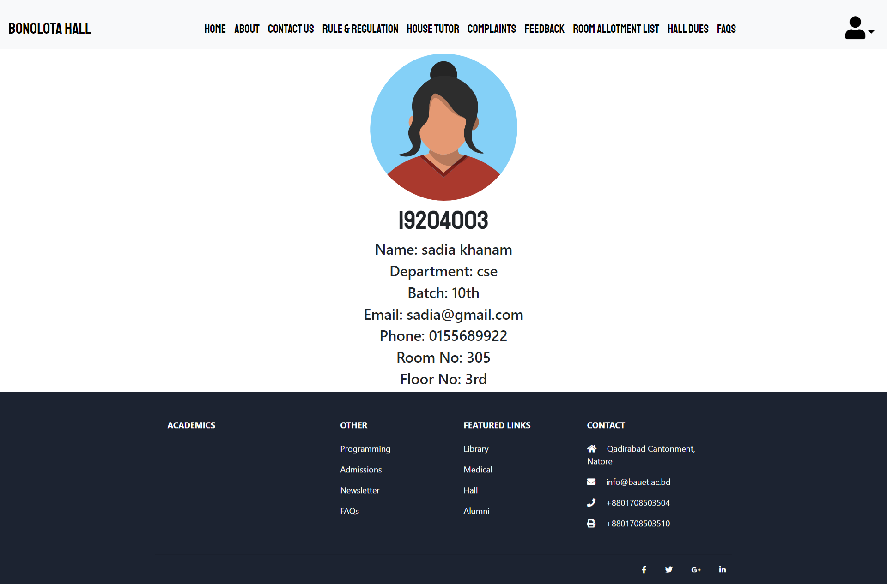
Project View Cont.
Fig 8: Student Profile

Slide 17
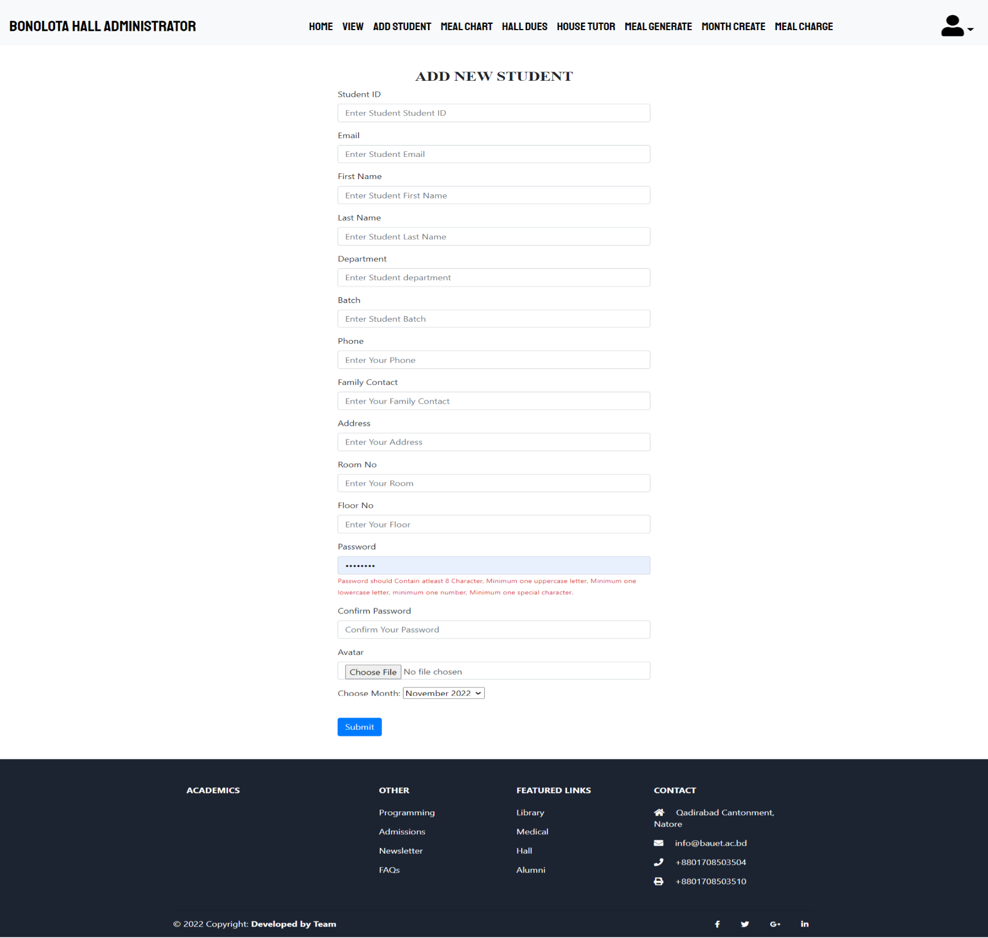
Project View Cont.
Fig 9: Admin add student Details

Slide 18
Conclusions
Several user friendly coding have also adopted. This package shall prove to be a powerful package in satisfying all the requirements of the organization. The objective of software planning is to provide a frame work that enables the manger to make reasonable estimates made within a limited time frame at the beginning of the software project and should be updated regularly as the project progress.
This website provides a computerized version of hall management system which will benefit the students as well as the visitor of the hall.

Slide 19
Future Works
The following are the future scope for the project.
Should be added payment gateway for students
Can be added staff management system
Can be added multiple halls
Can be added multilingual to this site
And many features can be added this project to make it more robust.

Slide 20
References
[1] https://www.w3schools.com/php/default.asp
[2] https://www.php.net/
[3] https://www.guru99.com/software-testing-introduction-importance.html
[4] https://myclasscampus.com/home/school-erp-hostel-management-software
[5] https://www.getapp.com/hospitality-travel-software/hostel-management/

Slide 21
THANKS!

Slide 22
ANY QUESTION???

